Slide 1

Secure Network Assessment Tool (SNAT)
Final Project Report
This report details the development of the Secure Network Assessment Tool (SNAT), a project for the Data Structures and Algorithms (CS221) course.
1
2
Team Members
Course & Instructor
MUHAMMAD SAIM - 2024453
Data Structures and Algorithms - CS221
MUHAMMAD HARIS ZAFAR - 2024396
Dr. Zubair Ahmad
MUHAMMAD IBRAHIM GULZAR - 2024409
3
Submission Date
July 12, 2025

Slide 2

Project Overview: SNAT
SNAT addresses the critical need for efficient tools to assess, monitor, and manage network security. It provides automated risk assessment, vulnerability detection, and comprehensive reporting capabilities for modern IT infrastructure.
Problem Statement
Project Objectives
Organizations require efficient tools to assess, monitor, and manage their network security posture. SNAT provides automated risk assessment, vulnerability detection, and comprehensive reporting.
Implement core data structures for efficient system management.
Apply multiple sorting and searching algorithms.
Provide an interactive user interface for network assessment.
Generate detailed security reports.
Demonstrate practical application of DSA concepts.

Slide 3

Key Features of SNAT
SNAT is designed with a robust set of features to provide a comprehensive network security assessment experience.
Dynamic System Management
Automated Security Assessment
Multiple Sorting Options
Includes 5 different algorithms with performance comparison tools and time complexity analysis.
Add, delete, and search systems in real-time using a circular doubly linked list for flexible traversal.
Simulates port scanning, detects vulnerabilities, and calculates risk scores on a 0-100 scale.
Data Persistence
User-Friendly Interface
Allows saving/loading network configurations and generating detailed reports using a file-based storage system.
A menu-driven system with input validation and clear error messages for ease of use.

Slide 4


SNAT System Architecture
The SNAT system is structured into distinct layers, ensuring modularity, maintainability, and clear separation of concerns.
User Interface
Business Logic
menu.cpp, input.cpp
algorithm.cpp, main.cpp
Data Structure
File I/O
structure.cpp
fileio.cpp
This layered approach allows for independent development and testing of each component, contributing to the overall robustness and scalability of the application.

Slide 5
Implemented Data Structures
SNAT leverages several fundamental data structures to manage network systems, tasks, and risk data efficiently.
Circular Doubly Linked List
Stack (LIFO)
Queue (FIFO)
Manages network systems, allowing bidirectional traversal and dynamic sizing. Ideal for sequential scanning and assessment.
Used for task workflow management, such as vulnerability assessment, ensuring tasks are executed in reverse order of addition.
Schedules system scanning tasks, processing systems in the order they were added for fair scheduling.
Operations: O(1) push/pop.
Operations: O(1) enqueue/dequeue.
Operations: O(1) add, O(n) delete/search.
Binary Search Tree (BST)
Arrays
Organizes systems based on risk scores, enabling quick searches within specific risk ranges and sorted display.
Stores port lists, services, vulnerabilities, and risk calculation weights, offering O(1) random access and predictable memory use.
Operations: O(log n) average insert/search.

Slide 6
Sorting Algorithms in SNAT
SNAT incorporates five different sorting algorithms, each with distinct performance characteristics, for organizing network systems by risk score.
1
Selection Sort
Complexity: O(n²) time, O(1) space. Simple, suitable for small datasets.
2
Bubble Sort
Complexity: O(n²) worst, O(n) best time, O(1) space. Good for nearly sorted data.
3
Insertion Sort
Complexity: O(n²) worst, O(n) best time, O(1) space. Excellent for small or incrementally added datasets.
4
Quick Sort
Complexity: O(n log n) average time, O(log n) space. Fast average-case performance for large datasets.
5
Merge Sort
Complexity: O(n log n) guaranteed time, O(n) space. Stable and predictable performance for large datasets.

Slide 7
Searching & Risk Calculation
SNAT employs efficient searching algorithms and a weighted formula to determine system risk scores.
Searching Algorithms
Risk Calculation Algorithm
Linear Search
The risk score is calculated based on several weighted factors, capped at 100.
Complexity: O(n) time, O(1) space.
Password Strength
Use Case: Unsorted data, searching by system name.
1
25% weight
Binary Search
Complexity: O(log n) time, O(1) space.
Open Ports
2
Requirement: Sorted array.
30% weight
Use Case: Searching by risk score after sorting.
Encryption Status
3
15% weight
Malware Detection
4
20% weight
Firewall Status
5
10% weight

Slide 8
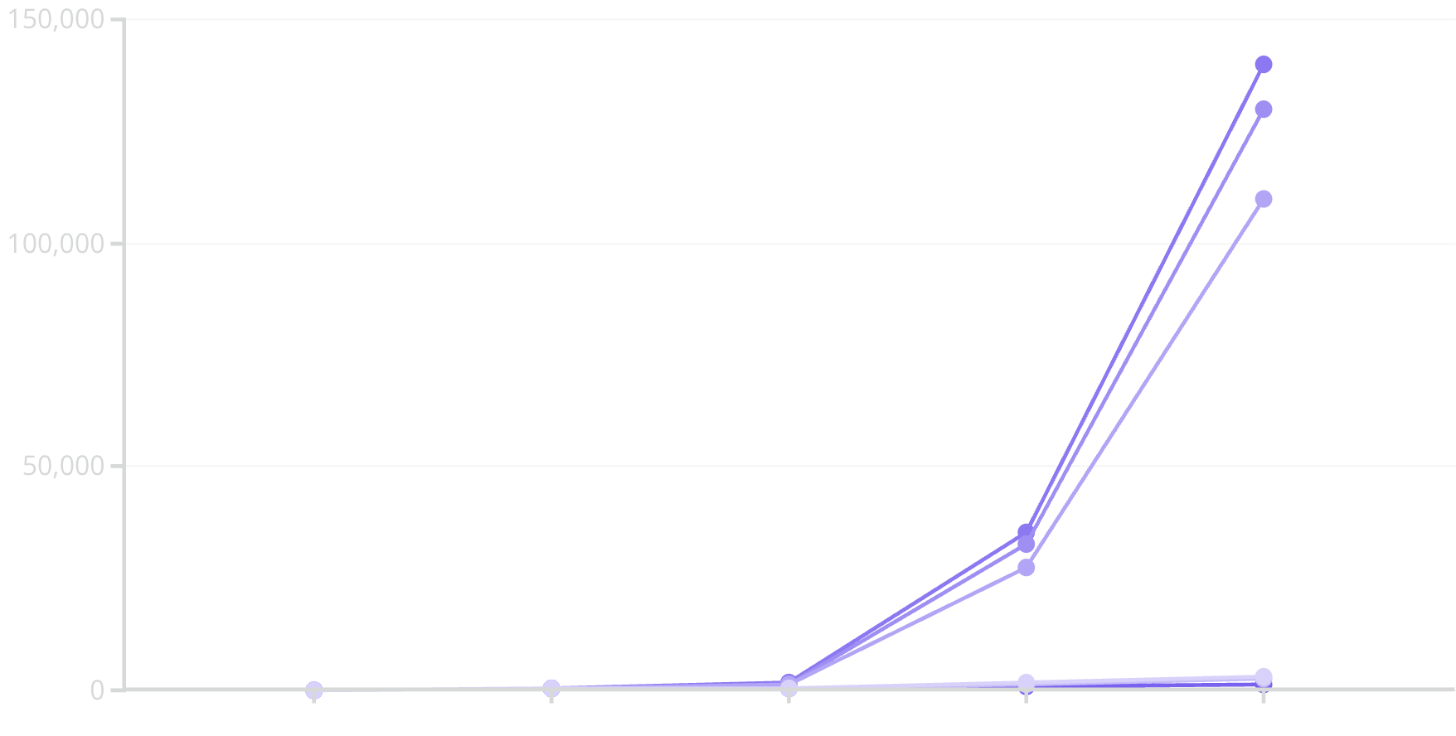

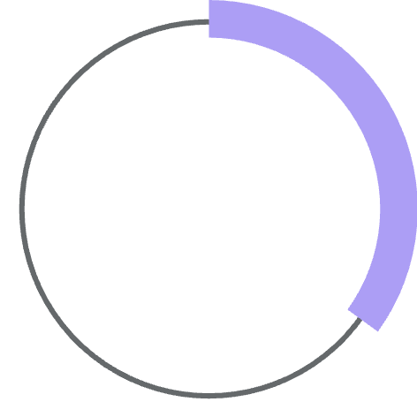
Performance Analysis & Validation
Extensive testing and analysis confirm SNAT's efficiency and reliability, aligning experimental results with theoretical complexities.
Sorting Algorithm Comparison
Testing and Validation
For datasets over 100 systems, O(n log n) algorithms (Quick Sort, Merge Sort) are significantly faster than O(n²) algorithms. Quick Sort generally performs best in practice.
SNAT underwent rigorous testing, including unit, integration, system, and user acceptance tests. All 35 test cases passed, demonstrating 100% correctness and reliability.
100%
Pass Rate
All test cases passed successfully.
Dataset Size
Selection (μs)
Bubble (μs)
Insertion (μs)
Quick (μs)
Merge (μs)
35
Total Tests
Comprehensive test suite covering all functionalities.
Edge cases, input validation, and file I/O were specifically tested to ensure robustness.

Slide 9
Challenges & Solutions
Developing SNAT presented several challenges, each overcome with targeted solutions and valuable learning outcomes.
Circular Linked List Deletion
Problem: Infinite loops when deleting the head node.
Solution: Implemented specific handling for single-node lists and proper circular connection updates.
Memory Leaks
Problem: Unfreed memory upon system deletion.
Solution: Implemented a proper destructor to free system data and nodes, verified with memory profilers.
Sorting Performance
Problem: O(n²) algorithms were too slow for larger datasets.
Solution: Integrated O(n log n) algorithms (Quick Sort, Merge Sort) and a comparison tool.
File Parsing
Problem: Commas in system names conflicted with delimiters.
Solution: Switched to a pipe delimiter (|) to avoid data corruption.
Input Validation
Problem: Invalid user inputs caused crashes.
Solution: Implemented comprehensive validation checks for all user inputs, especially for IP addresses and names.

Slide 10

Conclusion: SNAT's Impact & Future
SNAT successfully bridges theoretical computer science with practical cybersecurity applications, demonstrating the power of well-chosen data structures and algorithms.
Learning Outcomes
Future Improvements
Technical Skills
Advanced Data Structures
Deep understanding of data structure trade-offs, practical algorithm implementation, performance analysis, and modular design.
1
Hash Tables, Graphs, Priority Queues for enhanced functionality.
Problem-Solving
Sophisticated Algorithms
Breaking complex problems, choosing appropriate data structures, debugging, and memory management.
2
AVL Trees, Dijkstra's, Dynamic Programming for optimization.
Feature Expansion
Software Engineering
3
Real network scanning, GUI, database backend, multi-threading, ML, cloud integration.
Clean code principles, documentation, version control, and testing methodologies.
Security Enhancements
4
Encryption, authentication, and audit logging.

